Slide 1
Sarcasm Target Detection
Understanding the model and its intuition

Slide 2
Model Summary
Input sarcastic text concatenated with a dummy word at the end of the sentence
Each word is passed through an embedding layer to initialize them through pre-trained embeddings
The word representations are then passed to a LSTM or bidirectional LSTM
We concatenate the hidden vectors of rightmost LSTM cell in left context, the central word LSTM cell hidden vector and the hidden vector of leftmost LSTM cell in right context, and pass them to a dense layer
The dense representation is then concatenated with socio-linguistic features as we have obtained for central word
The output is then passed to linear layer with sigmoid activation function for classification

Slide 3
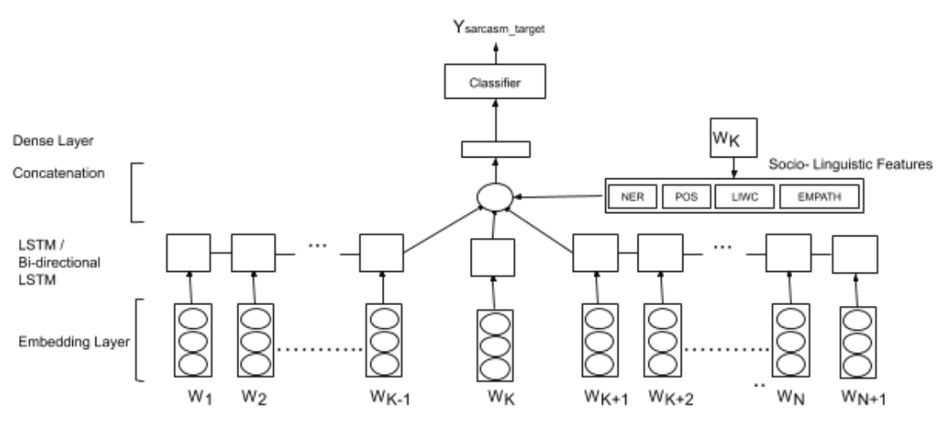

Slide 4
Analysis of Model Components
Embedding Layer
LSTM and bidirectional LSTM
Socio-linguistic features

Slide 5
Embedding Layer
GLOVE - GloVe is an unsupervised learning algorithm for obtaining vector representations for words.
Fast-text- library that allows users to learn text representations and text classifiers
ELMo - ELMo is a novel way to represent words in vectors or embeddings.
BERT - Bidirectional Encoder Representations from Transformers

Slide 6
LSTM
Capable of learning long-term dependencies
Explicitly designed to avoid the long-term dependency problem
Does not suffer from vanishing and exploding gradients problem

Slide 7
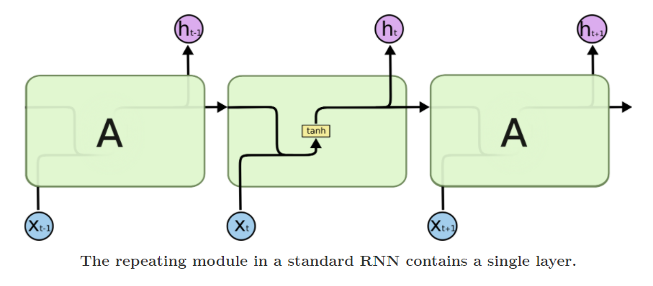
Standard RNN

Slide 8
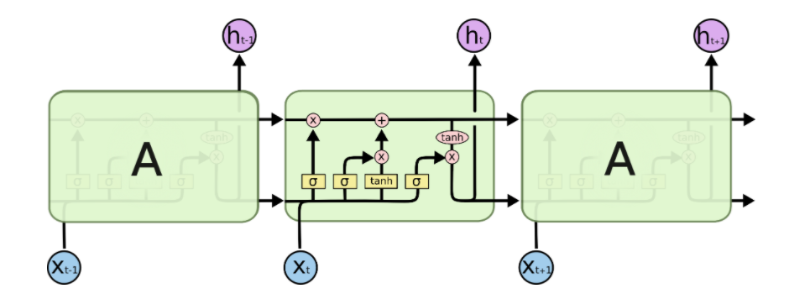
LSTM

Slide 9
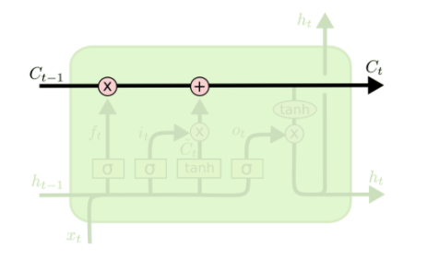
Memory Pipe

Slide 10
Step-by-Step LSTM Walk Through

Slide 11
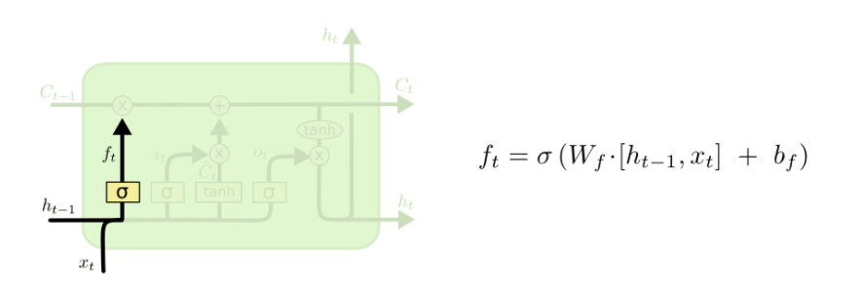
Forget Valve

Slide 12
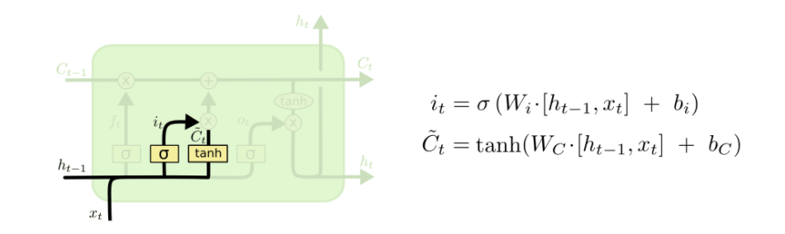
New Memory Valve

Slide 13
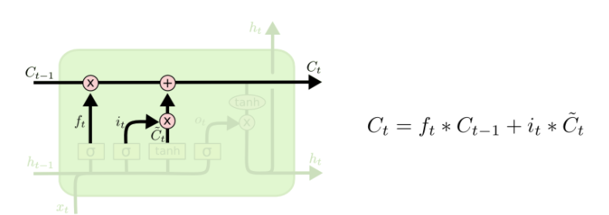
New Memory Calculation

Slide 14
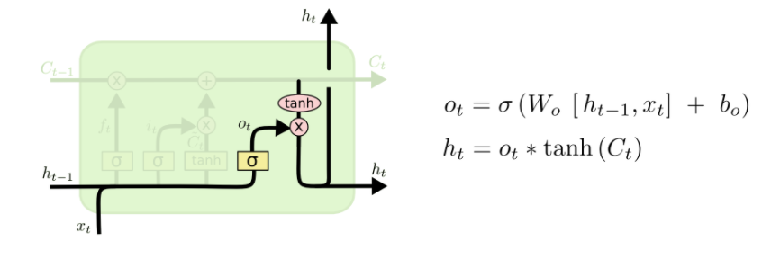
Output Generation

Slide 15
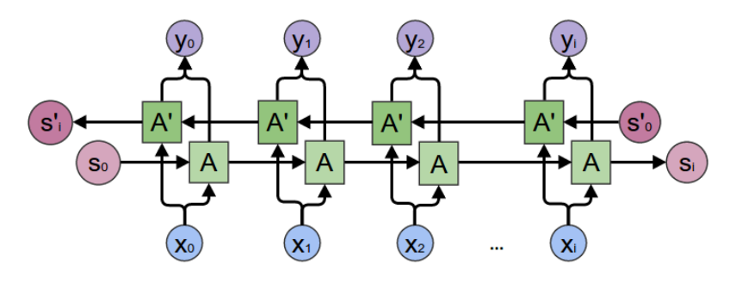
Bidirectional LSTM
Putting two independent LSTMs together.
Allows the networks to have both backward and forward information about the sequence at every time step
One LSTM runs input from past to future and other LSTM runs input from future to past

Slide 16
Socio-linguistic Features
Named Entity Recognition (NER)
Part of Speech (PoS)
Linguistic Inquiry and Word Count (LIWC)
EMPATH

Slide 17
Thank You

